Slide 1
Module5 Understanding Fixed-Income Risk and Return
MACAULAY AND MODIFIED DURATION
The duration of a bond measures the sensitivity of the bond’s full price (including accrued interest) to changes in the bond’s yield-to-maturity or, more generally, to changes in benchmark interest rates.
Yield duration is the sensitivity of the bond price with respect to the bond’s own yield-to-maturity. Curve duration is the sensitivity of the bond price (or more generally, the market value of a financial asset or liability) with respect to a benchmark yield curve.
Yield duration statistics used in fixed-income analysis include Macaulay duration, modified duration, money duration, and the price value of a basis point (PVBP). A curve duration statistic often used is effective duration.

Slide 2
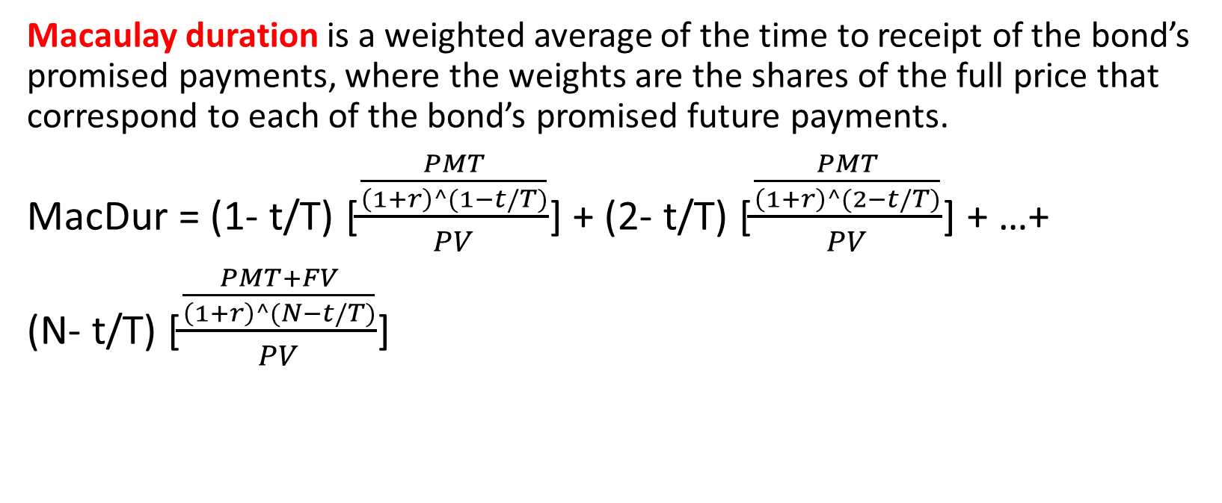
Module5 Understanding Fixed-Income Risk and Return
Macaulay duration is a weighted average of the time to receipt of the bond’s promised payments, where the weights are the shares of the full price that correspond to each of the bond’s promised future payments.
MacDur = (1- t/T) [$\frac{\frac{PMT}{\left(1+r\right)^(1−t/T)}}{PV}$] + (2- t/T) [$\frac{\frac{PMT}{\left(1+r\right)^(2−t/T)}}{PV}$] + …+
(N- t/T) [$\frac{\frac{PMT+FV}{\left(1+r\right)^(N−t/T)}}{PV}$]

Slide 3
Module5 Understanding Fixed-Income Risk and Return
Macaulay Duration of a 10-year, 8% annual payment bond
Period | Cash flow | Present value | Weight | Period*weight
1 | 8 | 7.246377 | 0.08475 | 0.0847
2 | 8 | 6.563747 | 0.07677 | 0.1535
3 | 8 | 5.945423 | 0.06953 | 0.2086
4 | 8 | 5.385347 | 0.06298 | 0.2519
5 | 8 | 4.878032 | 0.05705 | 0.2853
6 | 8 | 4.418507 | 0.05168 | 0.3101
7 | 8 | 4.002271 | 0.04681 | 0.3277
8 | 8 | 3.625245 | 0.04240 | 0.3392
9 | 8 | 3.283737 | 0.03840 | 0.3456
10 | 108 | 40.154389 | 0.46963 | 4.6963
 |  | 85.503075 | 1 | 7.0029

Slide 4
Module5 Understanding Fixed-Income Risk and Return
Macaulay duration of a five-year, 6% semiannual payment bond priced to yield 6%. A 6% semiannual payment corporate bond that matures on 14 February 2023 is purchased for settlement on 11 April 2019. The coupon payments are 3 per 100 of par value, paid on 14 February and 14 August of each year. 30/360 method to count days.
Period | Time to receipt | Cash flow | Present value | Weight | Time*weight
1 | 0.6833 | 3 | 2.940012326 | 0.029126 | 0.019903
2 | 1.6833 | 3 | 2.854380899 | 0.028278 | 0.047601
3 | 2.6833 | 3 | 2.771243591 | 0.027454 | 0.073669
4 | 3.6833 | 3 | 2.690527758 | 0.026655 | 0.098178
5 | 4.6833 | 3 | 2.612162872 | 0.025878 | 0.121197
6 | 5.6833 | 3 | 2.536080458 | 0.025125 | 0.142791
7 | 6.6833 | 3 | 2.462214037 | 0.024393 | 0.163025
8 | 7.6833 | 103 | 82.07380124 | 0.813092 | 6.247253
 |  |  | 100.9404232 | 1 | 6.913616
Notes:
o

Slide 5
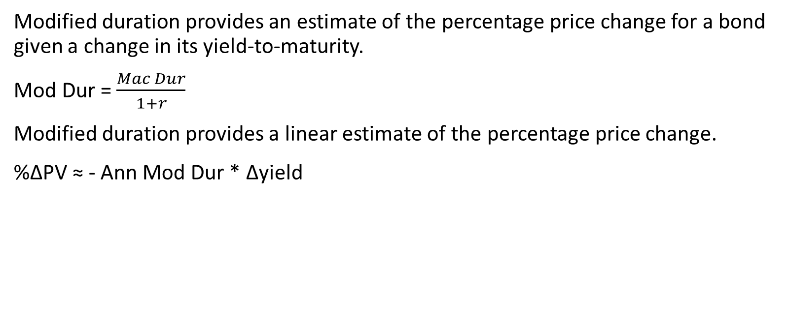
Module5 Understanding Fixed-Income Risk and Return
Modified duration provides an estimate of the percentage price change for a bond given a change in its yield-to-maturity.
Mod Dur = $\frac{Mac Dur}{1+r}$
Modified duration provides a linear estimate of the percentage price change.
%ΔPV ≈ - Ann Mod Dur * Δyield

Slide 6
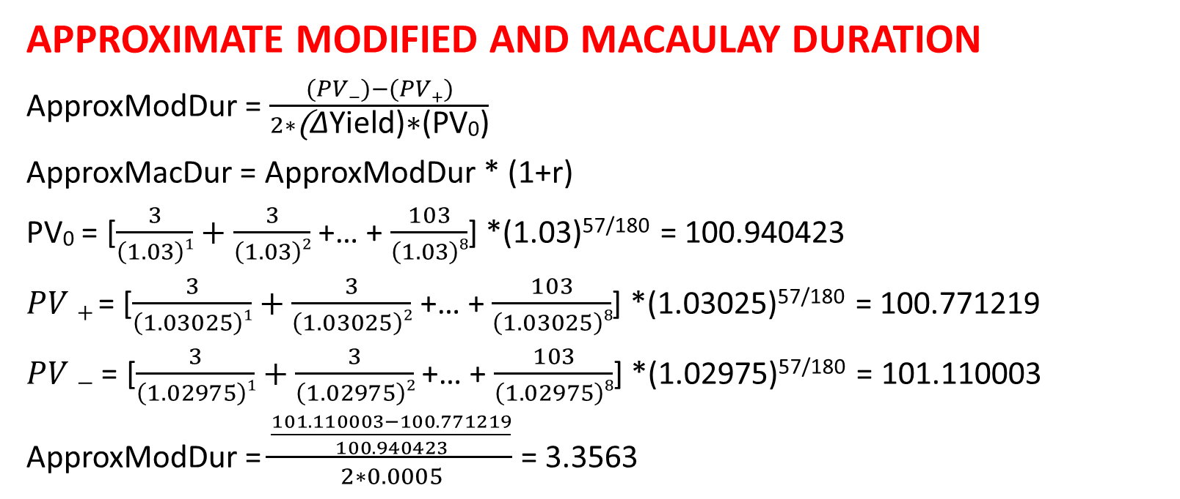
Module5 Understanding Fixed-Income Risk and Return
APPROXIMATE MODIFIED AND MACAULAY DURATION
ApproxModDur = $\frac{(PV−)−(PV+)}{2∗\text{(}\text{Δ}\text{Yield}\text{)∗(}\text{PV}\text{0}\text{)}}$
ApproxMacDur = ApproxModDur * (1+r)
$\text{PV}\text{0}$ = [$\frac{3}{\left(1.03\right)1}+\frac{3}{\left(1.03\right)2}$ +… + $\frac{103}{\left(1.03\right)8}$] *(1.03)^{57/180} = 100.940423
$PV+$= [$\frac{3}{\left(1.03025\right)1}+\frac{3}{\left(1.03025\right)2}$ +… + $\frac{103}{\left(1.03025\right)8}$] *(1.03025)^{57/180} = 100.771219
$PV−$ = [$\frac{3}{\left(1.02975\right)1}+\frac{3}{\left(1.02975\right)2}$ +… + $\frac{103}{\left(1.02975\right)8}$] *(1.02975)^{57/180} = 101.110003
ApproxModDur = $\frac{\frac{101.110003−100.771219}{100.940423}}{2∗0.0005}$ = 3.3563

